Slide 1
Machine Learning Logistic Regression Support Vector Machines
Francesco Pugliese, PhD
francesco.pugliese@istat.it
Vamsi Guturi, Data Scientist
vamsivarmagunturi@gmail.com

Slide 2
We will discuss about…
What is Logistic Regression ?
What is Support Vector Machines ?

Slide 3
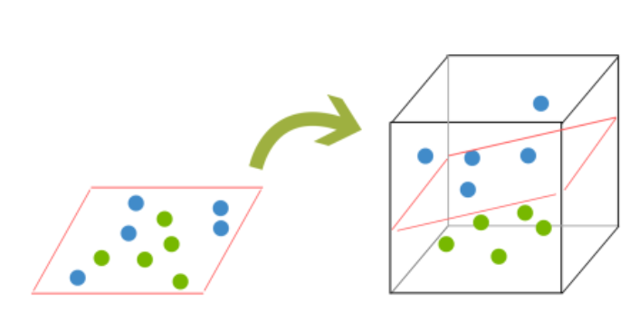
SUPPORT VECTOR MACHINES (SVMs)
A Support Vector Machine (SVM) is a supervised machine learning algorithm that can be employed for both classification and regression purposes.
THE PROBLEM OF DIVIDING THE DATASET INTO TWO OR MORE CLASSES

Slide 4
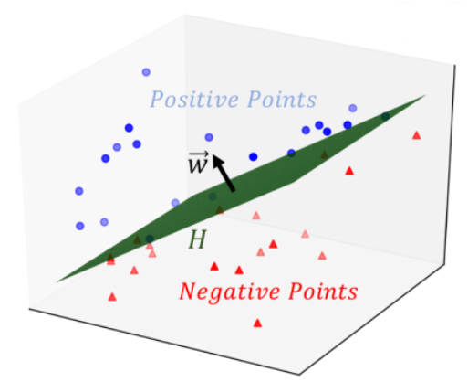
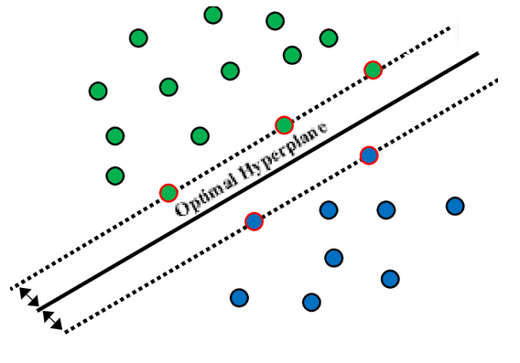
SUPPORT VECTOR MACHINES (SVMs)
SVMs are a machine learning model that is based on the idea of finding a hyperplane that best divides a dataset into two classes, as shown in the image below.
2D Case
3D Case

Slide 5
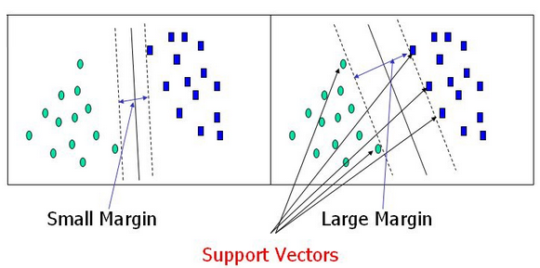
SUPPORT VECTOR MACHINES (SVMs)
Support Vectors are the data points nearest to the hyperplane, the points of a data set that, if removed, would alter the position of the dividing hyperplane. Because of this, they can be considered the critical elements of a data set..

Slide 6
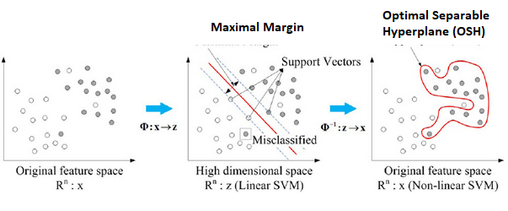
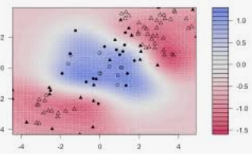
SUPPORT VECTOR MACHINES (SVMs)
Compared to both logistic regression and neural networks, a SVM sometimes gives a cleaner way of learning non-linear functions

Slide 7
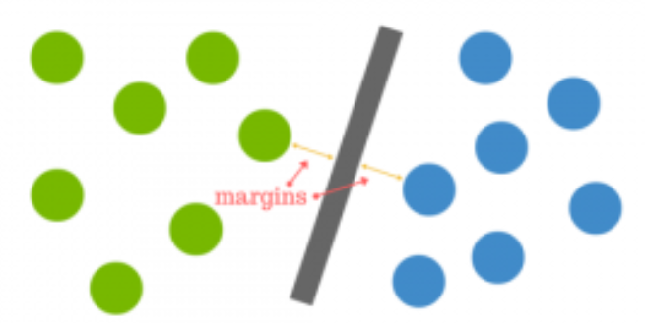
SUPPORT VECTOR MACHINES (SVMs)
Compared to both logistic regression and neural networks, a SVM sometimes gives a cleaner way of learning non-linear functions
The distance between the hy- perplane and the nearest data point from either set is known as the margin. The goal is to choose a hyperplane with the greatest possible margin between the hyperplane and any point within the training set, giving a greater chance of new data being classified correctly.

Slide 8
Logistic Regression: a revision for SVM
The Logistic Regression algorithm determines what class a new input should fall into, that’s why Y is a discrete value.
Classification problems
Email -> spam/not spam?
Online transactions -> fraudulent?
Tumor -> Malignant/benign
Variable in these problems is YY is either 0 or 1
0 = negative class (absence of something)
1 = positive class (presence of something)
Let’s start with binary class problems. We can always implement a multiclass classification problem, which is an extension of the binary classification

Slide 9
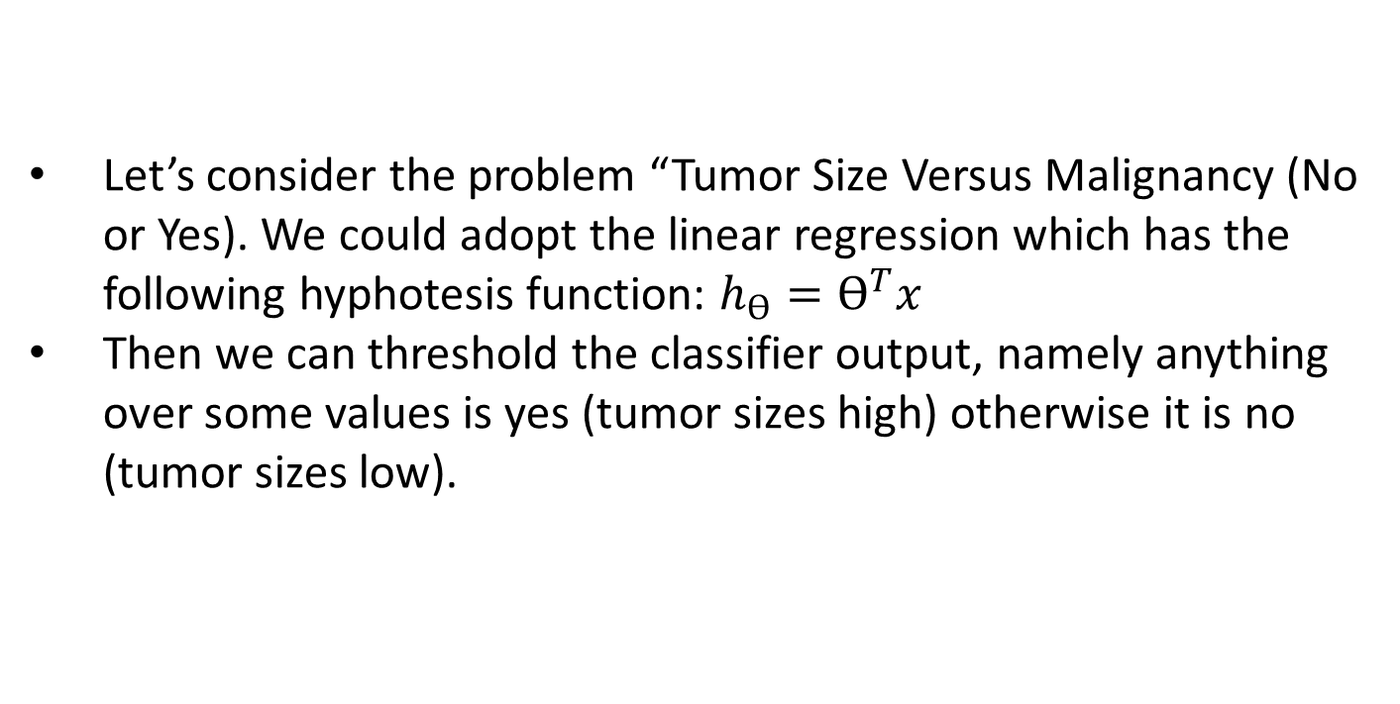

Let’s consider the problem “Tumor Size Versus Malignancy (No or Yes). We could adopt the linear regression which has the following hyphotesis function: $h_{ϴ}=ϴ^{T}x$
Then we can threshold the classifier output, namely anything over some values is yes (tumor sizes high) otherwise it is no (tumor sizes low).
Logistic Regression: a revision for SVM
Malignant
$$h_{ϴ}=ϴ^{T}x$$
(X)
XXXXX
0.5
What if we had a single Yes with a very small tumor?
OOOOO
Tumor Size

Slide 10
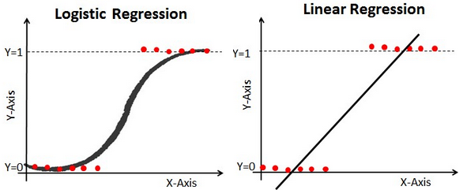
We can see previously above this does a reasonable job of stratifying the data points into one of two classes but in some cases we might have some yes classified as nos !!!.
By using a linear regression with threshold We might have small tumors classified as NO!! Moreover, with linear regression, output values van be larger than 1 or less than 0
Logistic Regression: a revision for SVM
Instead, we need to generate a value that is alway either 0 or 1. This is ccalled a «Classification problem».

Slide 11
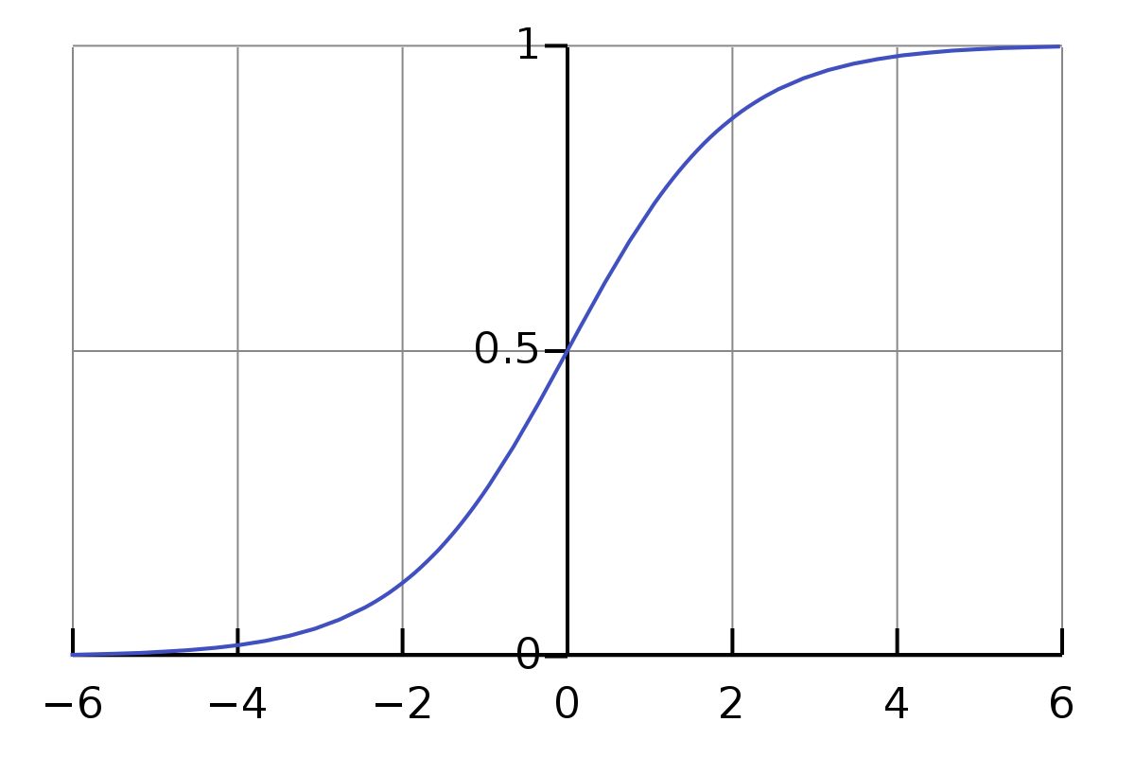
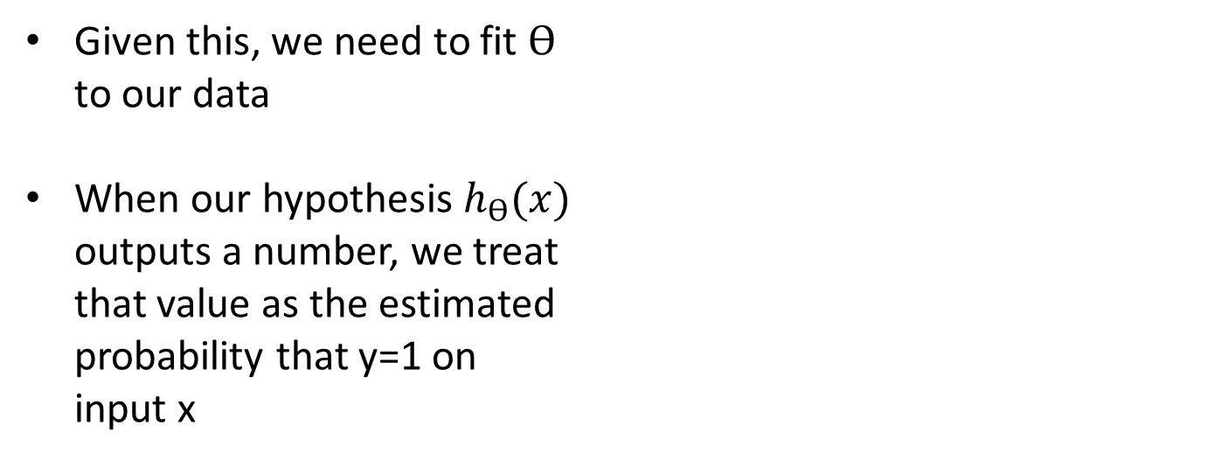
Logistic Regression: Hypothesis function
Sigmoid function looks like a curve that crosses 0.5 at the origin, then flattens out asymptotically at 0 and 1.
Given this, we need to fit $ϴ$
to our data
When our hypothesis $h_{ϴ}(x)$
outputs a number, we treat
that value as the estimated
probability that y=1 on
input x

Slide 12
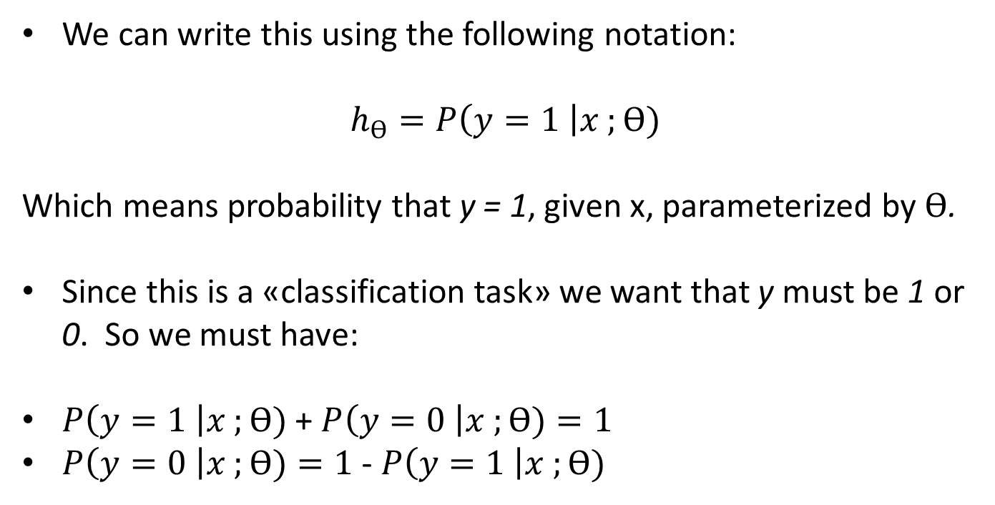
Logistic Regression: Hypothesis function
We can write this using the following notation:
$$h_{ϴ}=P\left(y=1 \right|x ;ϴ)$$
Which means probability that y = 1, given x, parameterized by $ϴ$.
Since this is a «classification task» we want that y must be 1 or 0. So we must have:
$P\left(y=1 \right|x ;ϴ)$+ $P\left(y=0 \right|x ;ϴ)=1$
$P\left(y=0 \right|x ;ϴ)=1$ - $P\left(y=1 \right|x ;ϴ)$

Slide 13
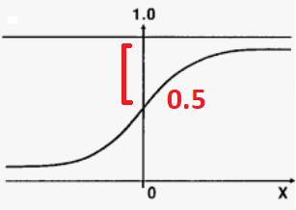
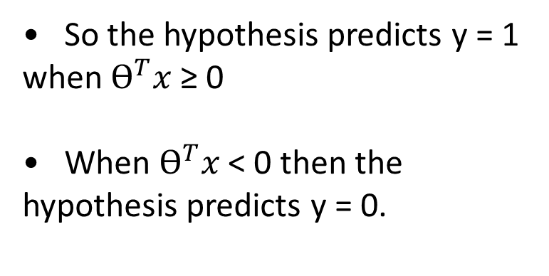
One way of using the sigmoid function is:
1) When the probability of y being 1 is greater than 0.5 then we can predict y = 1
2) Else we predict y = 0
Logistic Regression: Decision Boundary
So the hypothesis predicts y = 1 when $ϴ^{T}x$ ≥ 0
When $ϴ^{T}x$ < 0 then the hypothesis predicts y = 0.

Slide 14
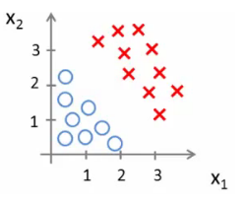
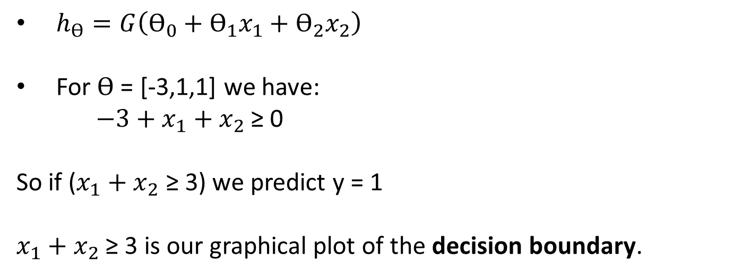
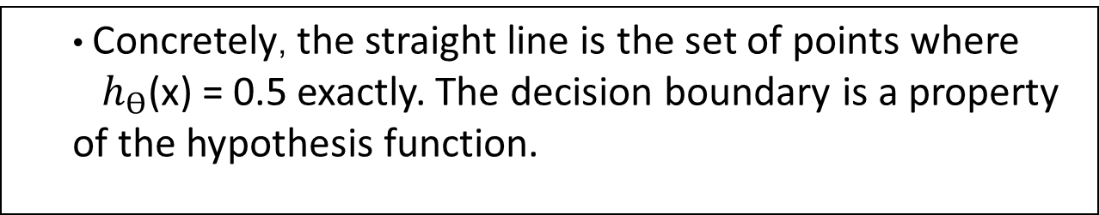
Logistic Regression: Decision Boundary
$h_{ϴ}=G\left(ϴ_{0}+ϴ_{1}x_{1}+ϴ_{2}x_{2}\right)$
For $ϴ$ = [-3,1,1] we have:
$−3+x_{1}+x_{2}$ ≥ 0
So if ($x_{1}+x_{2}$ ≥ 3) we predict y = 1
$x_{1}+x_{2}$ ≥ 3 is our graphical plot of the decision boundary.
Concretely, the straight line is the set of points where
$h_{ϴ}$(x) = 0.5 exactly. The decision boundary is a property of the hypothesis function.

Slide 15
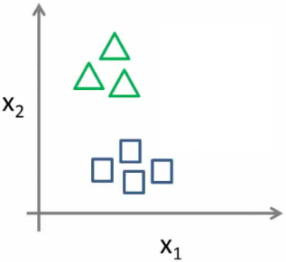
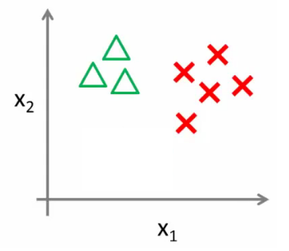
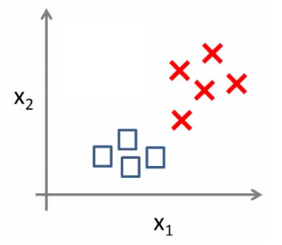




Logistic Regression: Multiclass Classification Problem
We split the training set into three separate binary classification problems.
$${h_{ϴ}}^{(1)} (x)$$
$${h_{ϴ}}^{(2)} (x)$$
$${h_{ϴ}}^{(3)} (x)$$
Train a logistic regression classifier for each class i in order to predict the probability that y = 1
On a new input, x to make a prediction, pick the class i that maximizes the probability that
$${h_{ϴ}}^{(i)} (x)$$

Slide 16
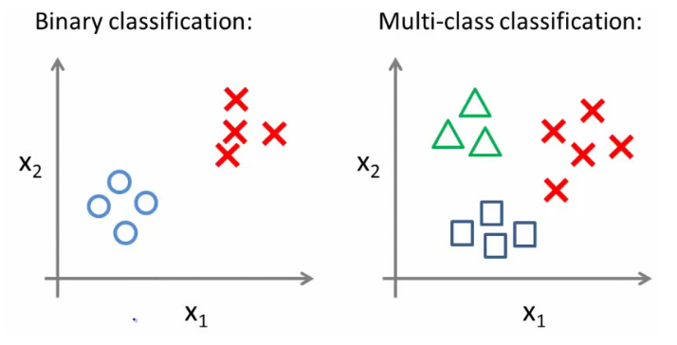
Logistic Regression: Multiclass Classification Problem
We adopt a one vs. all classification that makes a binary classification work for a multi-class classification.

Slide 17
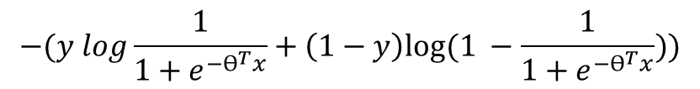
Back to SVMs: Loss Function
Alternative view of Logistic Regression. If we look at the loss (cost) function:
each example contributes a term like the one below to the overall cost function
For the overall cost function, we sum over all the training examples using the above function, and have a 1/m term. So we get:
$$−(y log{ h}_{ϴ}\left(x\right)+\left(1−y\right)log{(1− h}_{ϴ}\left(x\right)))$$
$$−(y log\frac{1}{1+e^{−ϴ^{T}x}}+\left(1−y\right)log⁡(1 −\frac{1}{1+e^{−ϴ^{T}x}}))$$

Slide 18
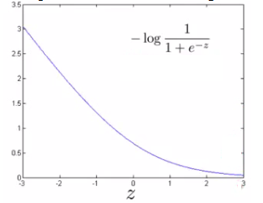
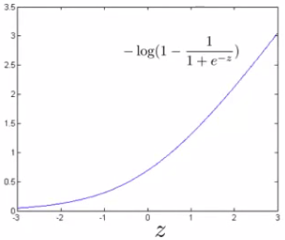
Back to SVMs: Loss Function
So each training example contributes that term to the cost function for logistic regression.
If y = 1 then only the first term in the objective matters. If we plot the functions vs. z we get the chart beside. If z is big, the cost is low and this is good!
But if z is 0 or negative the cost contribution is high.

Slide 19
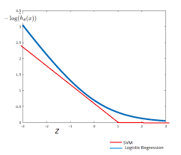
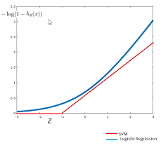
Back to SVMs: Loss Function
Instead of a curved line we create two straight lines (red) which act as an approximation to the logistic regression y = 1 and y = 0 functions
So this is the new y=1 cost function that gives the SVM a computational advantage and an easier optimization problem. We call this function cost1(z). Equivalently we call the y=0 function as cost0(z).
Cost1
Cost0

Slide 20

Back to SVMs: Loss Function
In Logistic Regression the Loss Function was:
With Support Verctor Machines the Loss Function now is:
There is the regularizer term still, but something must change.

Slide 21

Back to SVMs: Loss Function
1. Get rid of the 1/m terms. This is just a slightly different convention
By removing 1/m we should get the same optimal values for 1/m is a
constant, so should get same optimization e.g. say you have a
minimization problem which minimizes to u = 5. If your cost function * by a constant, you still generates the minimal value. That minimal
value is different, but that's irrelevant.
2. For logistic regression we had two terms; Training data set term (i.e. that
we sum over m) = A. Regularization term (i.e. that we sum over n) = B. So we could describe it as A + λB. Need some way to deal with the trade-off between regularization and data set terms. Set different values for λ to parametrize this trade-off. Instead if parameterize- tion this as A + λB. For SVMs the convention is to use a different parameter called C. So do CA + B. If C were equal to 1/λ then the two functions (CA + B and A + λB) would give the same value.

Slide 22
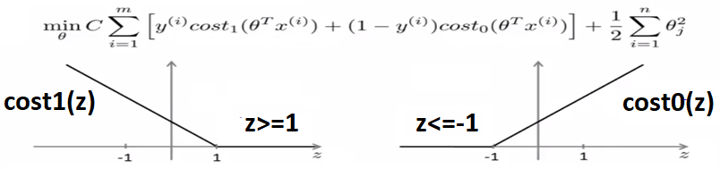
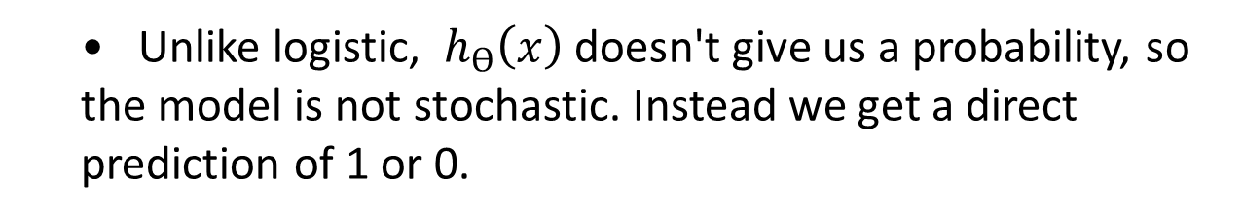
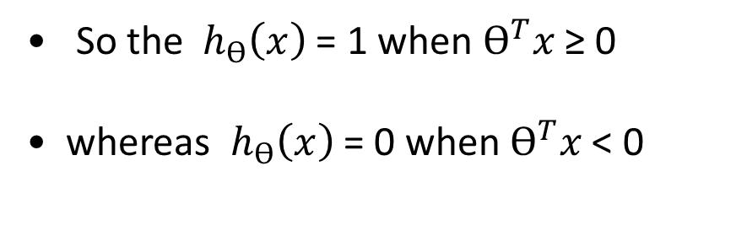
SVMs: Hypothesis Function
Unlike logistic, ${ h}_{ϴ}\left(x\right)$ doesn't give us a probability, so the model is not stochastic. Instead we get a direct prediction of 1 or 0.
So the ${ h}_{ϴ}\left(x\right)$ = 1 when $ϴ^{T}x$ ≥ 0
whereas ${ h}_{ϴ}\left(x\right)$ = 0 when $ϴ^{T}x$ < 0

Slide 23
So this is the new y=1 cost function Gives the SVM a computational advantage and an easier optimization problem
We call this function cost₁(z)
If y = 0 then only the second term matters. Same as before, if z is small then the cost is low and viceversa.

Slide 24
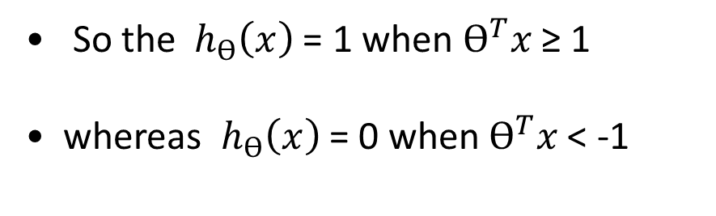
SVMs: Large Margin Intuition
Sometimes people refer to SVM as large margin classifiers.
So the ${ h}_{ϴ}\left(x\right)$ = 1 when $ϴ^{T}x$ ≥ 1
whereas ${ h}_{ϴ}\left(x\right)$ = 0 when $ϴ^{T}x$ < -1

Slide 25
Francesco Pugliese
Vamsi Gunturi
Sede Roma: Via Adriano Olivetti, 24 Tel: 06 43269281
Uffici Milano: Via Copernico, 38
Tel: 02 92852327
Reparto Marketing:
marketing@comedata.it
Reparto Commerciale:
sales@comedata.it
Social:
Facebook.com/comedata/@comedata | linkedin.com/company/comedata | yutube.com/user/Comedata

